Slide 1
14
MULTIVARIABLE FUNCTIONS AND PARTIAL DERIVATIVES

Slide 2
GRAPHS OF MULTIVARIABLE FUNCTIONS
We can visualize the graph S of f as lying directly above or below its domain D in the xy-plane.

Slide 3
GRAPHS
Example
Sketch the graph of the function f(x, y) = 6 – 3x – 2y
The graph of f has the equation z = 6 – 3x – 2y or 3x + 2y + z = 6
This represents a plane.

Slide 4
GRAPHS
Example
To graph the plane, we first find the intercepts.
Putting y = z = 0 in the equation, we get x = 2 as the x-intercept.
Similarly, the y-intercept is 3 and the z-intercept is 6.

Slide 5
GRAPHS
Example
This helps us sketch the portion of the graph that lies in the first octant.

Slide 6
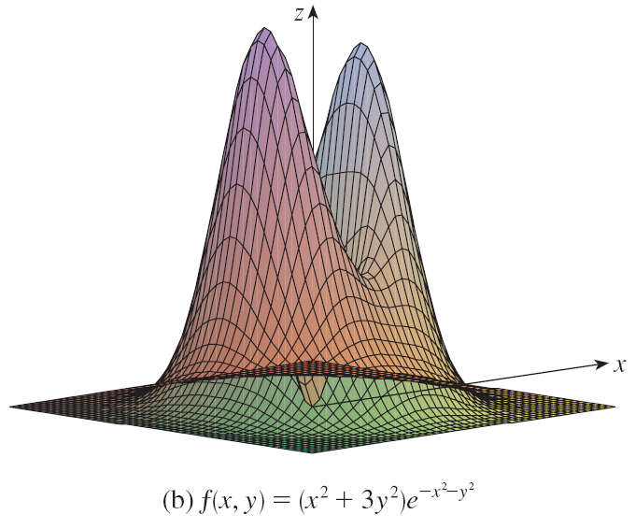
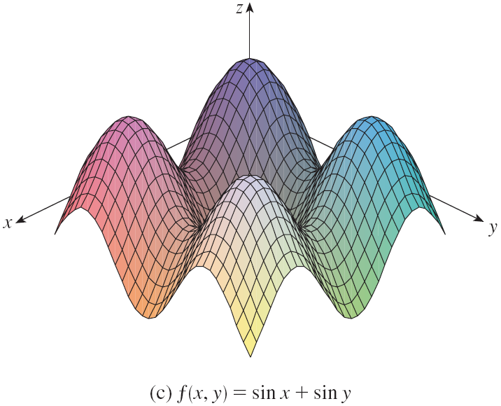
GRAPHS BY COMPUTERS
The figure shows computer-generated graphs of several functions.

Slide 7
GRAPHS BY COMPUTERS
Notice that we get an especially good picture of a function when rotation is used to give views from different vantage points.

Slide 8
GRAPHS BY COMPUTERS
In (a) and (b), the graph of f is very flat and close to the xy-plane except near the origin.
This is because e ^{–x2–y2} is small when x or y is large.

Slide 9
LEVEL CURVES
Definition
The level curves of a function f of two variables are the curves with equations f(x, y) = k where k is a constant (in the range of f).

Slide 10
LEVEL CURVE
A level curve f(x, y) = k is the set of all points in the domain of f at which f takes on a given value k.
That is, it shows where the graph of f has height k.

Slide 11
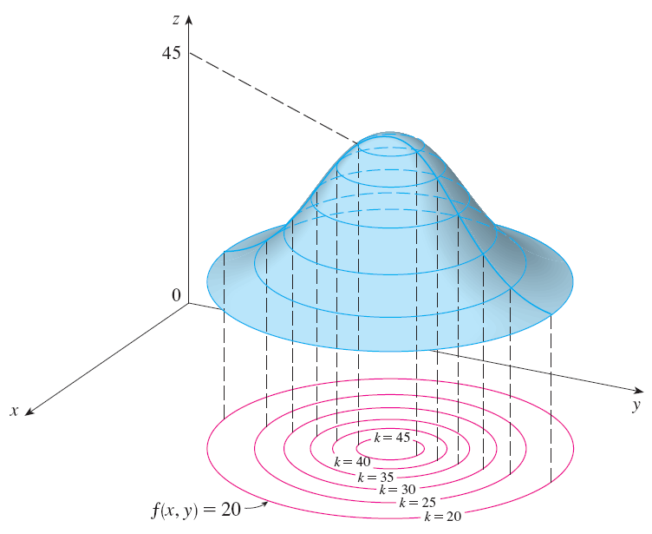
LEVEL CURVES
You can see from the figure the relation between level curves and horizontal traces.

Slide 12
LEVEL CURVES
The level curves f(x, y) = k are just the traces of the graph of f in the horizontal plane z = k projected down to the xy-plane.

Slide 13
LEVEL CURVES
So, suppose you draw the level curves of a function and visualize them being lifted up to the surface at the indicated height.
Then, you can mentally piece together a picture of the graph.

Slide 14
LEVEL CURVES
The surface is:
Steep where the level curves are close together.
Somewhat flatter where the level curves are farther apart.

Slide 15
LEVEL CURVES
One common example of level curves occurs in topographic maps of mountainous regions, such as shown.

Slide 16
LEVEL CURVES
The level curves are curves of constant elevation above sea level.
If you walk along one of these contour lines, you neither ascend nor descend.

Slide 17
LEVEL CURVES
Another common example is the temperature function introduced in the opening paragraph of the section.
Here, the level curves are called isothermals.
They join locations with the same temperature.

Slide 18
LEVEL CURVES
The figure shows a weather map of the world indicating the average January temperatures.

Slide 19
LEVEL CURVES
The isothermals are the curves that separate the colored bands.

Slide 20
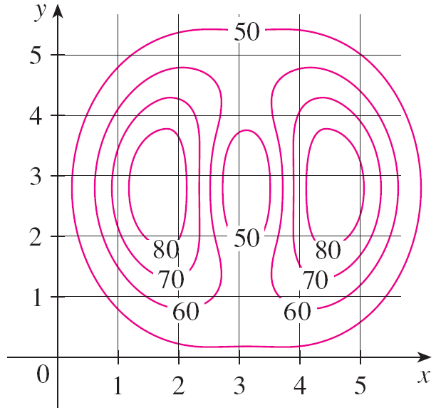
LEVEL CURVES
Example
A contour map for a function f is shown.
Use it to estimate the values of f(1, 3) and f(4, 5).

Slide 21
LEVEL CURVES
Example
The point (1, 3) lies partway between the level curves with z-values 70 and 80.
We estimate that: f(1, 3) ≈ 73
Similarly, we estimate that: f(4, 5) ≈ 56

Slide 22
LEVEL CURVES
Example
Sketch the level curves of the function f(x, y) = 6 – 3x – 2y for the values k = –6, 0, 6, 12

Slide 23
LEVEL CURVES
Example
The level curves are: 6 – 3x – 2y = k or 3x + 2y + (k – 6) = 0

Slide 24
LEVEL CURVES
Example
This is a family of lines with slope –3/2.
The four particular level curves with k = –6, 0, 6, 12 are:
3x + 2y – 12 = 0
3x + 2y – 6 = 0
3x + 2y = 0
3x + 2y + 6 = 0

Slide 25
LEVEL CURVES
Example
The level curves are equally spaced parallel lines because the graph of f is a plane.

Slide 26
LEVEL CURVES
Example
Sketch the level curves of the function for k = 0, 1, 2, 3
The level curves are:

Slide 27
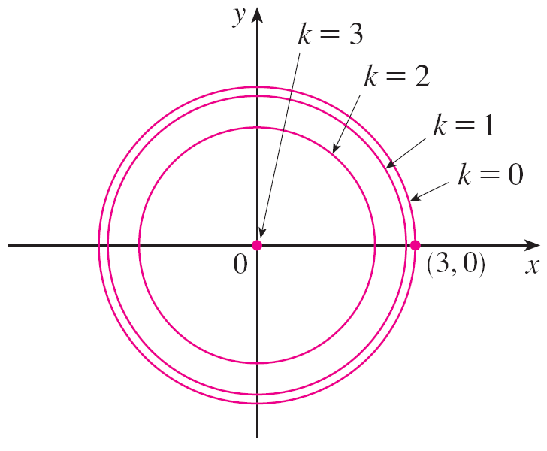
LEVEL CURVES
Example
This is a family of concentric circles with center (0, 0) and radius
The cases k = 0, 1, 2, 3 are shown.

Slide 28
LEVEL CURVES
Example
Try to visualize these level curves lifted up to form a surface.

Slide 29
LEVEL CURVES
Example
Then, compare the formed surface with the graph of g (a hemisphere), as in the other figure.

Slide 30
PARTIAL DERIVATIVES
Equations 4
If f is a function of two variables, its partial derivatives are the functions f_{x} and f_{y} defined by:

Slide 31
NOTATIONS
There are many alternative notations for partial derivatives.
For instance, instead of f_{x}, we can write f₁ or D₁f (to indicate differentiation with respect to the first variable) or ∂f/∂x.
However, here, ∂f/∂x can’t be interpreted as a ratio of differentials.

Slide 32
NOTATIONS FOR PARTIAL DERIVATIVES
If z = f(x, y), we write:

Slide 33
PARTIAL DERIVATIVES
To compute partial derivatives, all we have to do is:
Remember from Equation 1 that the partial derivative with respect to x is just the ordinary derivative of the function g of a single variable that we get by keeping y fixed.

Slide 34
RULE TO FIND PARTIAL DERIVATIVES OF z = f(x, y)
Thus, we have this rule.
To find f_{x}, regard y as a constant and differentiate f(x, y) with respect to x.
To find f_{y}, regard x as a constant and differentiate f(x, y) with respect to y.

Slide 35
PARTIAL DERIVATIVES
Example 1
If f(x, y) = x³ + x²y³ – 2y² find f_{x}(2, 1) and f_{y}(2, 1)

Slide 36
PARTIAL DERIVATIVES
Example 1
Holding y constant and differentiating with respect to x, we get: f_{x}(x, y) = 3x² + 2xy³
Thus, f_{x}(2, 1) = 3 . 2² + 2 . 2 . 1³ = 16

Slide 37
PARTIAL DERIVATIVES
Example 1
Holding x constant and differentiating with respect to y, we get: f_{y}(x, y) = 3x²y² – 4y
Thus, f_{y}(2, 1) = 3 . 2^{2 .} 1² – 4 . 1 = 8

Slide 38
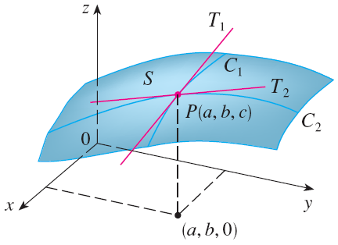
GEOMETRIC INTERPRETATION
To give a geometric interpretation of partial derivatives, we recall that the equation z = f(x, y) represents a surface S (the graph of f).
If f(a, b) = c, then the point P(a, b, c) lies on S.

Slide 39
GEOMETRIC INTERPRETATION
By fixing y = b, we are restricting our attention to the curve C₁ in which the vertical plane y = b intersects S.
That is, C₁ is the trace of S in the plane y = b.

Slide 40
GEOMETRIC INTERPRETATION
Likewise, the vertical plane x = a intersects S in a curve C₂.
Both the curves C₁ and C₂ pass through P.

Slide 41
GEOMETRIC INTERPRETATION
Notice that the curve C₁ is the graph of the function g(x) = f(x, b).
So, the slope of its tangent T₁ at P is: g’(a) = f_{x}(a, b)

Slide 42
GEOMETRIC INTERPRETATION
The curve C₂ is the graph of the function G(y) = f(a, y).
So, the slope of its tangent T₂ at P is: G’(b) = f_{y}(a, b)

Slide 43
GEOMETRIC INTERPRETATION
Thus, the partial derivatives f_{x}(a, b) and f_{y}(a, b) can be interpreted geometrically as:
The slopes of the tangent lines at P(a, b, c) to the traces C₁ and C₂ of S in the planes y = b and x = a.

Slide 44
INTERPRETATION AS RATE OF CHANGE
As seen in the case of the heat index function, partial derivatives can also be interpreted as rates of change.
If z = f(x, y), then ∂z/∂x represents the rate of change of z with respect to x when y is fixed.
Similarly, ∂z/∂y represents the rate of change of z with respect to y when x is fixed.

Slide 45
GEOMETRIC INTERPRETATION
Example
If
f(x, y) = 4 – x² – 2y²
find f_{x}(1, 1) and f_{y}(1, 1) and interpret these numbers as slopes.

Slide 46
GEOMETRIC INTERPRETATION
Example
We have:
f_{x}(x, y) = -2x f_{y}(x, y) = -4y
f_{x}(1, 1) = -2 f_{y}(1, 1) = -4

Slide 47
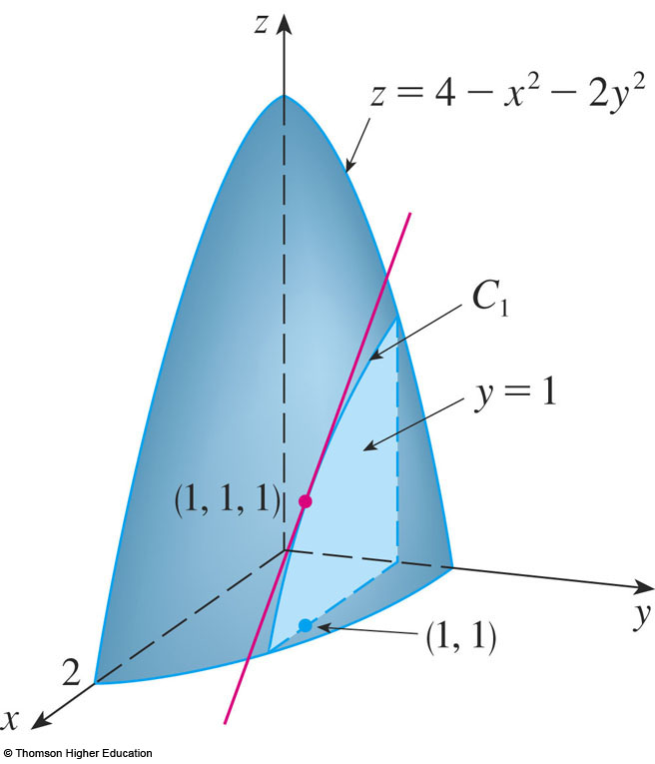
GEOMETRIC INTERPRETATION
Example
The graph of f is the paraboloid z = 4 – x² – 2y²
The vertical plane y = 1 intersects it in the parabola z = 2 – x², y = 1.
As discussed, we label it C₁.

Slide 48
GEOMETRIC INTERPRETATION
Example
The slope of the tangent line to this parabola at the point (1, 1, 1) is: f_{x}(1, 1) = -2

Slide 49
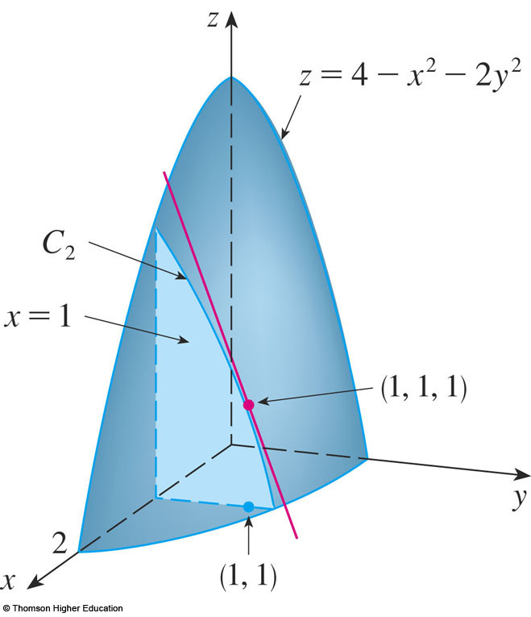
GEOMETRIC INTERPRETATION
Example
Similarly, the curve C₂ in which the plane x = 1 intersects the paraboloid is the parabola z = 3 – 2y², x = 1.
The slope of the tangent line at (1, 1, 1) is: f_{y}(1, 1) = – 4

Slide 50
PARTIAL DERIVATIVES
Example
If
calculate

Slide 51
PARTIAL DERIVATIVES
Example
Using the Chain Rule for functions of one variable, we have:

Slide 52
PARTIAL DERIVATIVES
Example
Find ∂z/∂x and ∂z/∂y if z is defined implicitly as a function of x and y by the equation x³ + y³ + z³ + 6xyz = 1

Slide 53
PARTIAL DERIVATIVES
Example
To find ∂z/∂x, we differentiate implicitly with respect to x, being careful to treat y as a constant:
Solving for ∂z/∂x, we obtain:

Slide 54
PARTIAL DERIVATIVES
Example
Similarly, implicit differentiation with respect to y gives:

Slide 55
FUNCTIONS OF MORE THAN TWO VARIABLES
Partial derivatives can also be defined for functions of three or more variables.
For example, if f is a function of three variables x, y, and z, then its partial derivative with respect to x is defined as:

Slide 56
FUNCTIONS OF MORE THAN TWO VARIABLES
It is found by:
Regarding y and z as constants.
Differentiating f(x, y, z) with respect to x.

Slide 57
FUNCTIONS OF MORE THAN TWO VARIABLES
If w = f(x, y, z), then f_{x} = ∂w/∂x can be interpreted as the rate of change of w with respect to x when y and z are held fixed.
However, we can’t interpret it geometrically since the graph of f lies in four-dimensional space.

Slide 58
FUNCTIONS OF MORE THAN TWO VARIABLES
In general, if u is a function of n variables, u = f(x₁, x₂, . . ., x_{n}), its partial derivative with respect to the i th variable x_{i} is:

Slide 59
FUNCTIONS OF MORE THAN TWO VARIABLES
Then, we also write:

Slide 60
MULTIPLE VARIABLE FUNCTIONS
Example
Find f_{x}, f_{y}, and f_{z} if f(x, y, z) = e^{xy} ln z
Holding y and z constant and differentiating with respect to x, we have: f_{x} = ye^{xy} ln z
Similarly, f_{y} = xe^{xy} ln z f_{z} = e^{xy}/z

Slide 61
HIGHER DERIVATIVES
If f is a function of two variables, then its partial derivatives f_{x} and f_{y} are also functions of two variables.

Slide 62
SECOND PARTIAL DERIVATIVES
So, we can consider their partial derivatives (f_{x})_{x} , (f_{x})_{y} , (f_{y})_{x} , (f_{y})_{y}
These are called the second partial derivatives of f.

Slide 63
NOTATION
If z = f(x, y), we use the following notation:

Slide 64
SECOND PARTIAL DERIVATIVES
Thus, the notation f_{xy} (or ∂²f/∂y∂x) means that we first differentiate with respect to x and then with respect to y.
In computing f_{yx} , the order is reversed.

Slide 65
SECOND PARTIAL DERIVATIVES
Example 6
Find the second partial derivatives of f(x, y) = x³ + x²y³ – 2y²
In Example 1, we found that: f_{x}(x, y) = 3x² + 2xy³ f_{y}(x, y) = 3x²y² – 4y

Slide 66
SECOND PARTIAL DERIVATIVES
Example 6
Hence,

Slide 67
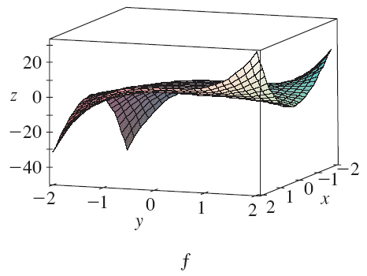
SECOND PARTIAL DERIVATIVES
The figure shows the graph of the function f in Example 6 for: –2 ≤ x ≤ 2, – 2 ≤ y ≤ 2

Slide 68
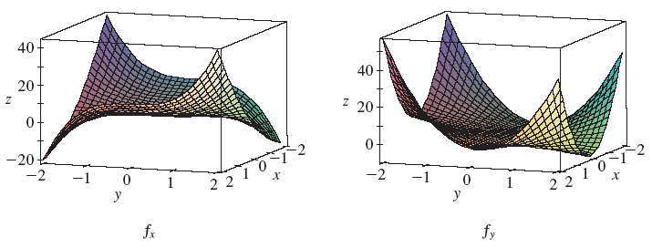
SECOND PARTIAL DERIVATIVES
These show the graphs of its first-order partial derivatives.

Slide 69
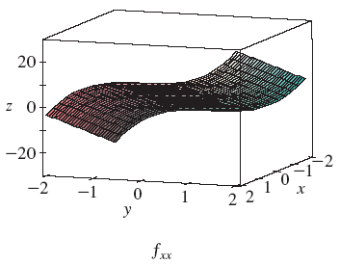
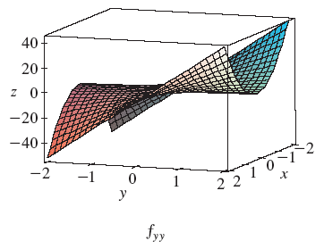
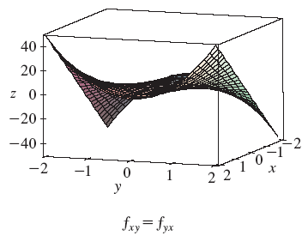
SECOND PARTIAL DERIVATIVES
These show the graphs of its second-order partial derivatives.

Slide 70
SECOND PARTIAL DERIVATIVES
Notice that f_{xy} = f_{yx} in the Example
This is not just a coincidence.
It turns out that the mixed partial derivatives f_{xy} and f_{yx} are equal for most functions that one meets in practice.

Slide 71
SECOND PARTIAL DERIVATIVES
The following theorem, discovered by the French mathematician Alexis Clairaut (1713–1765), gives conditions under which we can assert that f_{xy} = f_{yx} .
The proof is given in Appendix F.

Slide 72
CLAIRAUT’S THEOREM
Suppose f is defined on a disk D that contains the point (a, b).
If the functions f_{xy} and f_{yx} are both continuous on D, then
f_{xy}(a, b) = f_{yx}(a, b)

Slide 73
HIGHER DERIVATIVES
Partial derivatives of order 3 or higher can also be defined.
For instance,
Using Clairaut’s Theorem, it can be shown that f_{xyy} = f_{yxy} = f_{yyx} if these functions are continuous.

Slide 74
HIGHER DERIVATIVES
Example
Calculate f_{xxyz} if f(x, y, z) = sin(3x + yz)
f_{x} = 3 cos(3x + yz)
f_{xx} = –9 sin(3x + yz)
f_{xxy} = –9z cos(3x + yz)
f_{xxyz} = –9 cos(3x + yz) + 9yz sin(3x + yz)

Slide 75
TANGENT PLANES
Similarly, putting x = x₀ in Equation 1, we get: z – z₀ = b(y – y₀)
This must represent the tangent line T₂.
Thus, b = f_{y}(x₀, y₀).

Slide 76
TANGENT PLANES
Suppose a surface S has equation z = f(x, y), where f has continuous first partial derivatives.
Let P(x₀, y₀, z₀) be a point on S.

Slide 77
TANGENT PLANES
As in Section 14.3, let C₁ and C₂ be the curves obtained by intersecting the vertical planes y = y₀ and x = x₀ with the surface S.
Then, the point P lies on both C₁ and C₂.

Slide 78
TANGENT PLANES
Let T₁ and T₂ be the tangent lines to the curves C₁ and C₂ at the point P.

Slide 79
TANGENT PLANE
Then, the tangent plane to the surface S at the point P is defined to be the plane that contains both tangent lines T₁ and T₂.

Slide 80
TANGENT PLANES
We will see in Section 14.6 that, if C is any other curve that lies on the surface S and passes through P, then its tangent line at P also lies in the tangent plane.

Slide 81
TANGENT PLANES
Therefore, you can think of the tangent plane to S at P as consisting of all possible tangent lines at P to curves that lie on S and pass through P.
The tangent plane at P is the plane that most closely approximates the surface S near the point P.

Slide 82
TANGENT PLANES
We know from Equation 7 in Section 12.5 that any plane passing through the point P(x₀, y₀, z₀) has an equation of the form
A(x – x₀) + B(y – y₀) + C(z – z₀) = 0

Slide 83
TANGENT PLANES
Equation 1
By dividing that equation by C and letting a = –A/C and b = –B/C, we can write it in the form
z – z₀ = a(x – x₀) + b(y – y₀)

Slide 84
TANGENT PLANES
If Equation 1 represents the tangent plane at P, then its intersection with the plane y = y₀ must be the tangent line T₁.

Slide 85
TANGENT PLANES
Setting y = y₀ in Equation 1 gives:
z – z₀ = a(x – x₀) y = y₀
We recognize these as the equations (in point-slope form) of a line with slope a.

Slide 86
TANGENT PLANES
However, we know that the slope of the tangent T₁ is f_{x}(x₀, y₀).
Therefore, a = f_{x}(x₀, y₀).

Slide 87
TANGENT PLANES
Equation 2
Suppose f has continuous partial derivatives.
An equation of the tangent plane to the surface z = f(x, y) at the point P(x₀, y₀, z₀) is:
z – z₀ = f_{x}(x₀, y₀)(x – x₀) + f_{y}(x₀, y₀)(y – y₀)

Slide 88
TANGENT PLANES
Example 1
Find the tangent plane to the elliptic paraboloid z = 2x² + y² at the point (1, 1, 3).
Let f(x, y) = 2x² + y².
Then, f_{x}(x, y) = 4x f_{y}(x, y) = 2y f_{x}(1, 1) = 4 f_{y}(1, 1) = 2

Slide 89
TANGENT PLANES
Example 1
So, Equation 2 gives the equation of the tangent plane at (1, 1, 3) as: z – 3 = 4(x – 1) + 2(y – 1) or z = 4x + 2y – 3

Slide 90
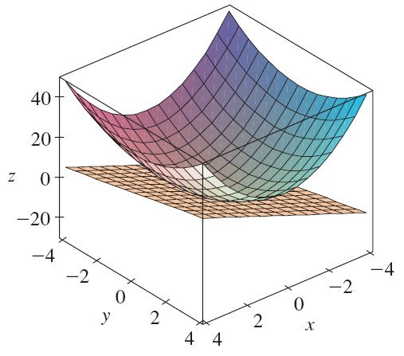
TANGENT PLANES
The figure shows the elliptic paraboloid and its tangent plane at (1, 1, 3) that we found in Example 1.

Slide 91
TANGENT PLANES
Here, we zoom in toward the point by restricting the domain of the function f(x, y) = 2x² + y².

Slide 92
TANGENT PLANES
Notice that, the more we zoom in,
The flatter the graph appears.
The more it resembles its tangent plane.

Slide 93
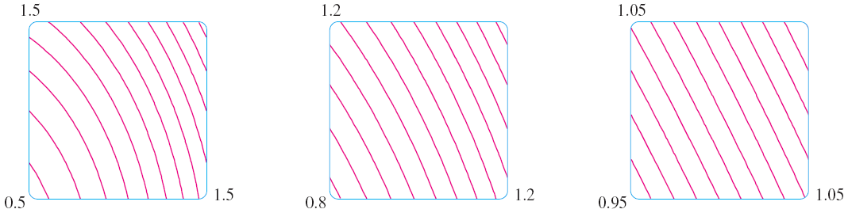
TANGENT PLANES
Here, we corroborate that impression by zooming in toward the point (1, 1) on a contour map of the function f(x, y) = 2x² + y².

Slide 94
TANGENT PLANES
Notice that, the more we zoom in, the more the level curves look like equally spaced parallel lines—characteristic of a plane.

Slide 95
LINEAR APPROXIMATIONS
In Example 1, we found that an equation of the tangent plane to the graph of the function f(x, y) = 2x² + y² at the point (1, 1, 3) is:
z = 4x + 2y – 3

Slide 96
LINEAR APPROXIMATIONS
Thus, in view of the visual evidence in the previous two figures, the linear function of two variables
L(x, y) = 4x + 2y – 3
is a good approximation to f(x, y) when (x, y) is near (1, 1).

Slide 97
LINEARIZATION & LINEAR APPROXIMATION
The function L is called the linearization of f at (1, 1).
The approximation f(x, y) ≈ 4x + 2y – 3 is called the linear approximation or tangent plane approximation of f at (1, 1).

Slide 98
LINEAR APPROXIMATIONS
For instance, at the point (1.1, 0.95), the linear approximation gives: f(1.1, 0.95) ≈ 4(1.1) + 2(0.95) – 3 = 3.3
This is quite close to the true value of f(1.1, 0.95) = 2(1.1)² + (0.95)² = 3.3225

Slide 99
LINEAR APPROXIMATIONS
However, if we take a point farther away from (1, 1), such as (2, 3), we no longer get a good approximation.
In fact, L(2, 3) = 11, whereas f(2, 3) = 17.

Slide 100
LINEAR APPROXIMATIONS
In general, we know from Equation 2 that an equation of the tangent plane to the graph of a function f of two variables at the point (a, b, f(a, b)) is:
z = f(a, b) + f_{x}(a, b)(x – a) + f_{y}(a, b)(y – b)

Slide 101
LINEARIZATION
Equation 3
The linear function whose graph is this tangent plane, namely
L(x, y) = f(a, b) + f_{x}(a, b)(x – a) + f_{y}(a, b)(y – b)
is called the linearization of f at (a, b).

Slide 102
LINEAR APPROXIMATION
Equation 4
The approximation
f(x, y) ≈ f(a, b) + f_{x}(a, b)(x – a) + f_{y}(a, b)(y – b)
is called the linear approximation or the tangent plane approximation of f at (a, b).

Slide 103
LINEAR APPROXIMATIONS
We have defined tangent planes for surfaces z = f(x, y), where f has continuous first partial derivatives.
What happens if f_{x} and f_{y} are not continuous?

Slide 104
LINEAR APPROXIMATIONS
The figure pictures such a function.
Its equation is:

Slide 105
LINEAR APPROXIMATIONS
You can verify (see Exercise 46) that its partial derivatives exist at the origin and, in fact, f_{x}(0, 0) = 0 and f_{y}(0, 0) = 0.
However, f_{x} and f_{y} are not continuous.

Slide 106
LINEAR APPROXIMATIONS
Thus, the linear approximation would be f(x, y) ≈ 0.
However, f(x, y) = ½ at all points on the line y = x.

Slide 107
LINEAR APPROXIMATIONS
Thus, a function of two variables can behave badly even though both of its partial derivatives exist.
To rule out such behavior, we formulate the idea of a differentiable function of two variables.

Slide 108
LINEAR APPROXIMATIONS
Recall that, for a function of one variable, y = f(x), if x changes from a to a + ∆x, we defined the increment of y as:
∆y = f(a + ∆x) – f(a)

Slide 109
LINEAR APPROXIMATIONS
Equation 5
In Chapter 3 we showed that, if f is differentiable at a, then ∆y = f’(a)∆x + ε∆x where ε → 0 as ∆x → 0

Slide 110
LINEAR APPROXIMATIONS
Now, consider a function of two variables, z = f(x, y).
Suppose x changes from a to a + ∆x and y changes from b to b + ∆x.

Slide 111
LINEAR APPROXIMATIONS
Equation 6
Then, the corresponding increment of z is:
∆z = f(a + ∆x, b + ∆y) – f(a, b)

Slide 112
LINEAR APPROXIMATIONS
Thus, the increment ∆z represents the change in the value of f when (x, y) changes from (a, b) to (a + ∆x, b + ∆y).
By analogy with Equation 5, we define the differentiability of a function of two variables as follows.

Slide 113
LINEAR APPROXIMATIONS
Definition 7
If z = f(x, y), then f is differentiable at (a, b) if ∆z can be expressed in the form
∆z = f_{x}(a, b) ∆x + f_{y}(a, b) ∆y + ε₁ ∆x + ε₂ ∆y
where ε₁ and ε₂ → 0 as (∆x, ∆y) → (0, 0).

Slide 114
LINEAR APPROXIMATIONS
Definition 7 says that a differentiable function is one for which the linear approximation in Equation 4 is a good approximation when (x, y) is near (a, b).
That is, the tangent plane approximates the graph of f well near the point of tangency.

Slide 115
LINEAR APPROXIMATIONS
It’s sometimes hard to use Definition 7 directly to check the differentiability of a function.
However, the next theorem provides a convenient sufficient condition for differentiability.

Slide 116
LINEAR APPROXIMATIONS
Theorem 8
If the partial derivatives f_{x} and f_{y} exist near (a, b) and are continuous at (a, b), then f is differentiable at (a, b).

Slide 117
LINEAR APPROXIMATIONS
Example
Show that f(x, y) = xe^{xy} is differentiable at (1, 0) and find its linearization there.
Then, use it to approximate f(1.1, –0.1).

Slide 118
LINEAR APPROXIMATIONS
Example
The partial derivatives are:
f_{x}(x, y) = e^{xy} + xye^{xy} f_{y}(x, y) = x²e^{xy} f_{x}(1, 0) = 1 f_{y}(1, 0) = 1
Both f_{x} and f_{y} are continuous functions.
So, f is differentiable by Theorem 8.

Slide 119
LINEAR APPROXIMATIONS
Example
The linearization is:
L(x, y) = f(1, 0) + f_{x}(1, 0)(x – 1) + f_{y}(1, 0)(y – 0)
= 1 + 1(x – 1) + 1 . y = x + y

Slide 120
LINEAR APPROXIMATIONS
Example
The corresponding linear approximation is: xe^{xy} ≈ x + y
So, f(1.1, – 0.1) ≈ 1.1 – 0.1 = 1
Compare this with the actual value of f(1.1, –0.1) = 1.1e^{–0.11} ≈ 0.98542

Slide 121
LINEAR APPROXIMATIONS
Example
Suppose the heat index (perceived temperature/”real feel”) I as a function of:
The actual temperature T
The relative humidity H

Slide 122
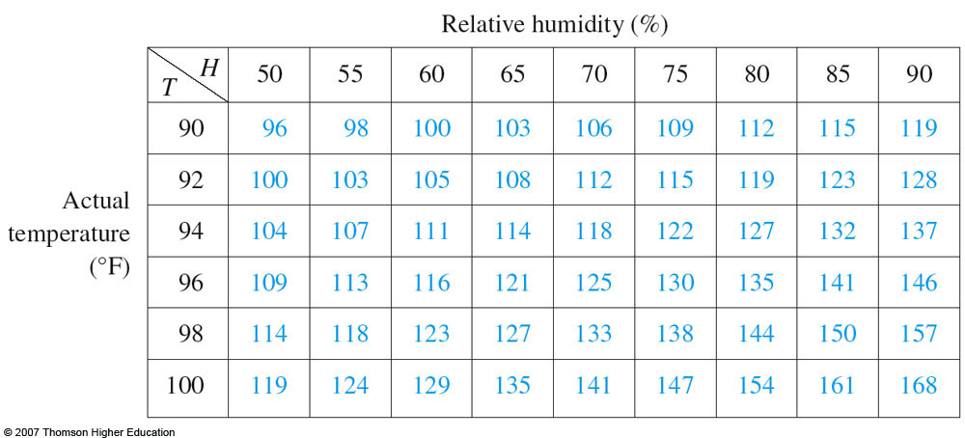
LINEAR APPROXIMATIONS
Example
We gave this table of values from the National Weather Service.

Slide 123
LINEAR APPROXIMATIONS
Example
Find a linear approximation for the heat index I = f(T, H) when T is near 96°F and H is near 70%.
Use it to estimate the heat index when the temperature is 97°F and the relative humidity is 72%.

Slide 124
LINEAR APPROXIMATIONS
Example
We read that f(96, 70) = 125.
In Section 14.3, we used the tabular values to estimate that: f_{T}(96, 70) ≈ 3.75 and f_{H}(96, 70) ≈ 0.9

Slide 125
LINEAR APPROXIMATIONS
Example
So, the linear approximation is:
f(T, H) ≈ f(96, 70) + f_{T}(96, 70)(T – 96)
+ f_{H}(96, 70)(H – 70)
≈ 125 + 3.75(T – 96) + 0.9(H – 70)

Slide 126
LINEAR APPROXIMATIONS
Example
In particular, f(92, 72) ≈ 125 + 3.75(1) + 0.9(2) = 130.55
Thus, when T = 97°F and H = 72%, the heat index is: I ≈ 131°F

Slide 127
PARTIAL DERIVATIVES
Directional Derivatives and the Gradient Vector
In this section, we will learn how to find:
The rate of changes of a function of
two or more variables in any direction.
Notes:
CHECK IF ACCURATE.

Slide 128
INTRODUCTION
This weather map shows a contour map of the temperature function T(x, y) for:
The states of California and Nevada at 3:00 PM on a day in October.

Slide 129
INTRODUCTION
The level curves, or isothermals, join locations with the same temperature.

Slide 130
INTRODUCTION
The partial derivative T_{x} is the rate of change of temperature with respect to distance if we travel east from Reno.
T_{y} is the rate of change if we travel north.

Slide 131
INTRODUCTION
However, what if we want to know the rate of change when we travel southeast (toward Las Vegas), or in some other direction?

Slide 132
DIRECTIONAL DERIVATIVE
In this section, we introduce a type of derivative, called a directional derivative, that enables us to find:
The rate of change of a function of two or more variables in any direction.

Slide 133
DIRECTIONAL DERIVATIVES
Equations 1
Recall that, if z = f(x, y), then the partial derivatives f_{x} and f_{y} are defined as:

Slide 134
DIRECTIONAL DERIVATIVES
Equations 1
They represent the rates of change of z in the x- and y-directions—that is, in the directions of the unit vectors i and j.

Slide 135
DIRECTIONAL DERIVATIVES
Suppose that we now wish to find the rate of change of z at (x₀, y₀) in the direction of an arbitrary unit vector u = <a, b>.

Slide 136
DIRECTIONAL DERIVATIVES
To do this, we consider the surface S with equation z = f(x, y) [the graph of f ] and we let z₀ = f(x₀, y₀).
Then, the point P(x₀, y₀, z₀) lies on S.

Slide 137
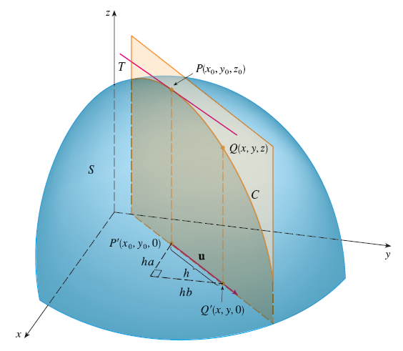
DIRECTIONAL DERIVATIVES
The vertical plane that passes through P in the direction of u intersects S in a curve C.

Slide 138
DIRECTIONAL DERIVATIVES
The slope of the tangent line T to C at the point P is the rate of change of z in the direction of u.

Slide 139
DIRECTIONAL DERIVATIVES
Now, let:
Q(x, y, z) be another point on C.
P’, Q’ be the projections of P, Q on the xy-plane.

Slide 140
DIRECTIONAL DERIVATIVES
Then, the vector is parallel to u.
So, for some scalar h.

Slide 141
DIRECTIONAL DERIVATIVES
Therefore, x – x₀ = ha y – y₀ = hb

Slide 142
DIRECTIONAL DERIVATIVES
So, x = x₀ + ha y = y₀ + hb

Slide 143
DIRECTIONAL DERIVATIVE
If we take the limit as h → 0, we obtain the rate of change of z (with respect to distance) in the direction of u.
This is called the directional derivative of f in the direction of u.

Slide 144
DIRECTIONAL DERIVATIVE
Definition 2
The directional derivative of f at (x₀, y₀) in the direction of a unit vector u = <a, b> is: if this limit exists.

Slide 145
DIRECTIONAL DERIVATIVES
Comparing Definition 2 with Equations 1, we see that:
If u = i = <1, 0>, then D_{i} f = f_{x}.
If u = j = <0, 1>, then D_{j} f = f_{y}.

Slide 146
DIRECTIONAL DERIVATIVES
In other words, the partial derivatives of f with respect to x and y are just special cases of the directional derivative.

Slide 147
DIRECTIONAL DERIVATIVES
Example 1
Use this weather map to estimate the value of the directional derivative of the temperature function at Reno in the southeasterly direction.

Slide 148
DIRECTIONAL DERIVATIVES
Example 1
The unit vector directed toward the southeast is: u = (i – j)/
However, we won’t need to use this expression.

Slide 149
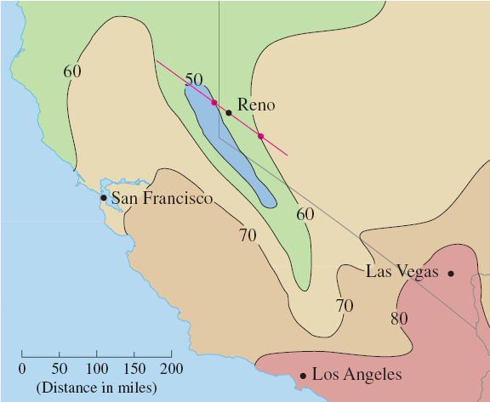
DIRECTIONAL DERIVATIVES
Example 1
We start by drawing a line through Reno toward the southeast.

Slide 150
DIRECTIONAL DERIVATIVES
Example 1
We approximate the directional derivative D_{u}T by:
The average rate of change of the temperature between the points where this line intersects the isothermals T = 50 and T = 60.

Slide 151
DIRECTIONAL DERIVATIVES
Example 1
The temperature at the point southeast of Reno is T = 60°F.
The temperature at the point northwest of Reno is T = 50°F.

Slide 152
DIRECTIONAL DERIVATIVES
Example 1
The distance between these points looks to be about 75 miles.

Slide 153
DIRECTIONAL DERIVATIVES
Example 1
So, the rate of change of the temperature in the southeasterly direction is:

Slide 154
DIRECTIONAL DERIVATIVES
When we compute the directional derivative of a function defined by a formula, we generally use the following theorem.

Slide 155
DIRECTIONAL DERIVATIVES
Theorem 3
If f is a differentiable function of x and y, then f has a directional derivative in the direction of any unit vector u = <a, b> and

Slide 156
DIRECTIONAL DERIVATIVES
Proof
If we define a function g of the single variable h by then, by the definition of a derivative, we have the following equation.

Slide 157
DIRECTIONAL DERIVATIVES
Proof—Equation 4

Slide 158
DIRECTIONAL DERIVATIVES
Proof
On the other hand, we can write: g(h) = f(x, y)
where:
x = x₀ + ha
y = y₀ + hb

Slide 159
DIRECTIONAL DERIVATIVES
Proof
Hence, the Chain Rule (Theorem 2 in Section 14.5) gives:

Slide 160
DIRECTIONAL DERIVATIVES
Proof—Equation 5
If we now put h = 0, then x = x₀ y = y₀ and

Slide 161
DIRECTIONAL DERIVATIVES
Proof
Comparing Equations 4 and 5, we see that:

Slide 162
DIRECTIONAL DERIVATIVES
Suppose the unit vector u makes an angle θ with the positive x-axis, as shown.

Slide 163
DIRECTIONAL DERIVATIVES
Equation 6
Then, we can write u = <cos θ, sin θ> and the formula in Theorem 3 becomes:

Slide 164
DIRECTIONAL DERIVATIVES
Example 2
Find the directional derivative D_{u}f(x, y) if:
f(x, y) = x³ – 3xy + 4y²
u is the unit vector given by angle θ = π/6
What is D_{u}f(1, 2)?

Slide 165
DIRECTIONAL DERIVATIVES
Example 2
Formula 6 gives:

Slide 166
DIRECTIONAL DERIVATIVES
Example 2
Therefore,

Slide 167
DIRECTIONAL DERIVATIVES
The directional derivative D_{u} f(1, 2) in Example 2 represents the rate of change of z in the direction of u.

Slide 168
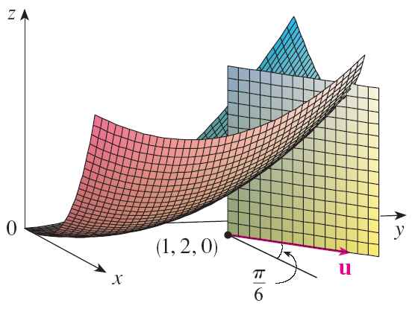
DIRECTIONAL DERIVATIVES
This is the slope of the tangent line to the curve of intersection of the surface z = x³ – 3xy + 4y² and the vertical plane through (1, 2, 0) in the direction of u shown here.

Slide 169
THE GRADIENT VECTOR
Expression 7
Notice from Theorem 3 that the directional derivative can be written as the dot product of two vectors:

Slide 170
THE GRADIENT VECTOR
The first vector in that dot product occurs not only in computing directional derivatives but in many other contexts as well.

Slide 171
THE GRADIENT VECTOR
So, we give it a special name:
The gradient of f
We give it a special notation too:
grad f or f , which is read “del f ”

Slide 172
THE GRADIENT VECTOR
Definition 8
If f is a function of two variables x and y, then the gradient of f is the vector function f defined by:

Slide 173
THE GRADIENT VECTOR
Example 3
If f(x, y) = sin x + e^{xy}, then

Slide 174
THE GRADIENT VECTOR
Equation 9
With this notation for the gradient vector, we can rewrite Expression 7 for the directional derivative as:
This expresses the directional derivative in the direction of u as the scalar projection of the gradient vector onto u.

Slide 175
THE GRADIENT VECTOR
Example 4
Find the directional derivative of the function f(x, y) = x²y³ – 4y at the point (2, –1) in the direction of the vector v = 2 i + 5 j.

Slide 176
THE GRADIENT VECTOR
Example 4
We first compute the gradient vector at (2, –1):

Slide 177
THE GRADIENT VECTOR
Example 4
Note that v is not a unit vector.
However, since , the unit vector in the direction of v is:

Slide 178
THE GRADIENT VECTOR
Example 4
Therefore, by Equation 9, we have:

Slide 179
FUNCTIONS OF THREE VARIABLES
For functions of three variables, we can define directional derivatives in a similar manner.
Again, D_{u} f(x, y, z) can be interpreted as the rate of change of the function in the direction of a unit vector u.

Slide 180
THREE-VARIABLE FUNCTION
Definition 10
The directional derivative of f at (x₀, y₀, z₀) in the direction of a unit vector u = <a, b, c> is: if this limit exists.

Slide 181
THREE-VARIABLE FUNCTIONS
If we use vector notation, then we can write both Definitions 2 and 10 of the directional derivative in a compact form, as follows.

Slide 182
THREE-VARIABLE FUNCTIONS
Equation 11
where:
x₀ = <x₀, y₀> if n = 2
x₀ = <x₀, y₀, z₀> if n = 3

Slide 183
THREE-VARIABLE FUNCTIONS
This is reasonable.
The vector equation of the line through x₀ in the direction of the vector u is given by x = x₀ + t u (Equation 1 in Section 12.5).
Thus, f(x₀ + hu) represents the value of f at a point on this line.

Slide 184
THREE-VARIABLE FUNCTIONS
Formula 12
If f(x, y, z) is differentiable and u = <a, b, c>, then the same method that was used to prove Theorem 3 can be used to show that:

Slide 185
THREE-VARIABLE FUNCTIONS
For a function f of three variables, the gradient vector, denoted by or grad f, is:

Slide 186
THREE-VARIABLE FUNCTIONS
Equation 13
For short,

Slide 187
THREE-VARIABLE FUNCTIONS
Equation 14
Then, just as with functions of two variables, Formula 12 for the directional derivative can be rewritten as:

Slide 188
THREE-VARIABLE FUNCTIONS
Example 5
If f(x, y, z) = x sin yz, find:
The gradient of f
The directional derivative of f at (1, 3, 0) in the direction of v = i + 2 j – k.

Slide 189
THREE-VARIABLE FUNCTIONS
Example 5 a
The gradient of f is:

Slide 190
THREE-VARIABLE FUNCTIONS
Example 5 b
At (1, 3, 0), we have:
The unit vector in the direction of v = i + 2 j – k is:

Slide 191
THREE-VARIABLE FUNCTIONS
Example 5
Hence, Equation 14 gives:

Slide 192
MAXIMIZING THE DIRECTIONAL DERIVATIVE
Suppose we have a function f of two or three variables and we consider all possible directional derivatives of f at a given point.
These give the rates of change of f in all possible directions.

Slide 193
MAXIMIZING THE DIRECTIONAL DERIVATIVE
We can then ask the questions:
In which of these directions does f change fastest?
What is the maximum rate of change?

Slide 194
MAXIMIZING THE DIRECTIONAL DERIVATIVE
The answers are provided by the following theorem.

Slide 195
MAXIMIZING DIRECTIONAL DERIV.
Theorem 15
Suppose f is a differentiable function of two or three variables.
The maximum value of the directional derivative D_{u}f(x) is:
It occurs when u has the same direction as the gradient vector

Slide 196
MAXIMIZING DIRECTIONAL DERIV.
Proof
From Equation 9 or 14, we have:
where θ is the angle between and u.

Slide 197
MAXIMIZING DIRECTIONAL DERIV.
Proof
The maximum value of cos θ is 1.
This occurs when θ = 0.
So, the maximum value of D_{u} f is:
It occurs when θ = 0, that is, when u has the same direction as .

Slide 198
MAXIMIZING DIRECTIONAL DERIV.
Example 6
If f(x, y) = xe^{y}, find the rate of change of f at the point P(2, 0) in the direction from P to Q(½, 2).

Slide 199
MAXIMIZING DIRECTIONAL DERIV.
Example 6
In what direction does f have the maximum rate of change? What is this maximum rate of change?

Slide 200
MAXIMIZING DIRECTIONAL DERIV.
Example 6 a
We first compute the gradient vector:

Slide 201
MAXIMIZING DIRECTIONAL DERIV.
Example 6 a
The unit vector in the direction of is .
So, the rate of change of f in the direction from P to Q is:

Slide 202
MAXIMIZING DIRECTIONAL DERIV.
Example 6 b
According to Theorem 15, f increases fastest in the direction of the gradient vector .
So, the maximum rate of change is:

Slide 203
MAXIMIZING DIRECTIONAL DERIV.
Example 7
Suppose that the temperature at a point (x, y, z) in space is given by T(x, y, z) = 80/(1 + x² + 2y² + 3z²) where:
T is measured in degrees Celsius.
x, y, z is measured in meters.

Slide 204
MAXIMIZING DIRECTIONAL DERIV.
Example 7
In which direction does the temperature increase fastest at the point (1, 1, –2)?
What is the maximum rate of increase?

Slide 205
MAXIMIZING DIRECTIONAL DERIV.
Example 7
The gradient of T is:

Slide 206
MAXIMIZING DIRECTIONAL DERIV.
Example 7
At the point (1, 1, –2), the gradient vector is:

Slide 207
MAXIMIZING DIRECTIONAL DERIV.
Example 7
By Theorem 15, the temperature increases fastest in the direction of the gradient vector
Equivalently, it does so in the direction of –i – 2 j + 6 k or the unit vector (–i – 2 j + 6 k)/ .

Slide 208
MAXIMIZING DIRECTIONAL DERIV.
Example 7
The maximum rate of increase is the length of the gradient vector:
Thus, the maximum rate of increase of temperature is:

Slide 209
TANGENT PLANES TO LEVEL SURFACES
Suppose S is a surface with equation F(x, y, z)
That is, it is a level surface of a function F of three variables.

Slide 210
TANGENT PLANES TO LEVEL SURFACES
Then, let P(x₀, y₀, z₀) be a point on S.

Slide 211
TANGENT PLANES TO LEVEL SURFACES
Then, let C be any curve that lies on the surface S and passes through the point P.
Recall from Section 13.1 that the curve C is described by a continuous vector function r(t) = <x(t), y(t), z(t)>

Slide 212
TANGENT PLANES TO LEVEL SURFACES
Let t₀ be the parameter value corresponding to P.
That is, r(t₀) = <x₀, y₀, z₀>

Slide 213
TANGENT PLANES
Equation 16
Since C lies on S, any point (x(t), y(t), z(t)) must satisfy the equation of S.
That is, F(x(t), y(t), z(t)) = k

Slide 214
TANGENT PLANES
Equation 17
If x, y, and z are differentiable functions of t and F is also differentiable, then we can use the Chain Rule to differentiate both sides of Equation 16:

Slide 215
TANGENT PLANES
However, as and Equation 17 can be written in terms of a dot product as:

Slide 216
TANGENT PLANES
Equation 18
In particular, when t = t₀, we have: r(t₀) = <x₀, y₀, z₀>
So,

Slide 217
TANGENT PLANES
Equation 18 says:
The gradient vector at P, , is perpendicular to the tangent vector r’(t₀) to any curve C on S that passes through P.

Slide 218
TANGENT PLANES
If , it is thus natural to define the tangent plane to the level surface F(x, y, z) = k at P(x₀, y₀, z₀) as:
The plane that passes through P and has normal vector

Slide 219
TANGENT PLANES
Equation 19
Using the standard equation of a plane (Equation 7 in Section 12.5), we can write the equation of this tangent plane as:

Slide 220
NORMAL LINE
The normal line to S at P is the line:
Passing through P
Perpendicular to the tangent plane

Slide 221
TANGENT PLANES
Thus, the direction of the normal line is given by the gradient vector

Slide 222
TANGENT PLANES
Equation 20
So, by Equation 3 in Section 12.5, its symmetric equations are:

Slide 223
TANGENT PLANES
Consider the special case in which the equation of a surface S is of the form z = f(x, y)
That is, S is the graph of a function f of two variables.

Slide 224
TANGENT PLANES
Then, we can rewrite the equation as F(x, y, z) = f(x, y) – z = 0 and regard S as a level surface (with k = 0) of F.

Slide 225
TANGENT PLANES
Then,

Slide 226
TANGENT PLANES
So, Equation 19 becomes:
This is equivalent to Equation 2 in Section 14.4

Slide 227
TANGENT PLANES
Thus, our new, more general, definition of a tangent plane is consistent with the definition that was given for the special case of Section 14.4

Slide 228
TANGENT PLANES
Example 8
Find the equations of the tangent plane and normal line at the point (–2, 1, –3) to the ellipsoid

Slide 229
TANGENT PLANES
Example 8
The ellipsoid is the level surface (with k = 3) of the function

Slide 230
TANGENT PLANES
Example 8
So, we have:

Slide 231
TANGENT PLANES
Example 8
Then, Equation 19 gives the equation of the tangent plane at (–2, 1, –3) as:
This simplifies to: 3x – 6y + 2z + 18 = 0

Slide 232
TANGENT PLANES
Example 8
By Equation 20, symmetric equations of the normal line are:

Slide 233
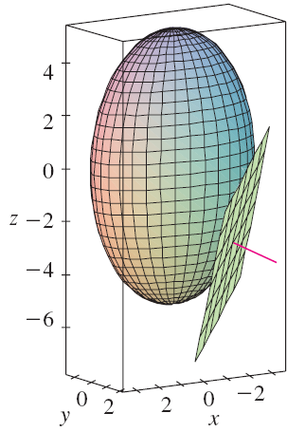
TANGENT PLANES
Example 8
The figure shows the ellipsoid, tangent plane, and normal line in Example 8.

Slide 234
SIGNIFICANCE OF GRADIENT VECTOR
We now summarize the ways in which the gradient vector is significant.

Slide 235
SIGNIFICANCE OF GRADIENT VECTOR
We first consider a function f of three variables and a point P(x₀, y₀, z₀) in its domain.

Slide 236
SIGNIFICANCE OF GRADIENT VECTOR
On the one hand, we know from Theorem 15 that the gradient vector gives the direction of fastest increase of f.

Slide 237
SIGNIFICANCE OF GRADIENT VECTOR
On the other hand, we know that is orthogonal to the level surface S of f through P.

Slide 238
SIGNIFICANCE OF GRADIENT VECTOR
These two properties are quite compatible intuitively.
As we move away from P on the level surface S, the value of f does not change at all.

Slide 239
SIGNIFICANCE OF GRADIENT VECTOR
So, it seems reasonable that, if we move in the perpendicular direction, we get the maximum increase.

Slide 240
SIGNIFICANCE OF GRADIENT VECTOR
In like manner, we consider a function f of two variables and a point P(x₀, y₀) in its domain.

Slide 241
SIGNIFICANCE OF GRADIENT VECTOR
Again, the gradient vector gives the direction of fastest increase of f.

Slide 242
SIGNIFICANCE OF GRADIENT VECTOR
Also, by considerations similar to our discussion of tangent planes, it can be shown that:
is perpendicular to the level curve f(x, y) = k that passes through P.

Slide 243
SIGNIFICANCE OF GRADIENT VECTOR
Again, this is intuitively plausible.
The values of f remain constant as we move along the curve.

Slide 244
SIGNIFICANCE OF GRADIENT VECTOR
Now, we consider a topographical map of a hill.
Let f(x, y) represent the height above sea level at a point with coordinates (x, y).

Slide 245
SIGNIFICANCE OF GRADIENT VECTOR
Then, a curve of steepest ascent can be drawn by making it perpendicular to all of the contour lines.

Slide 246
SIGNIFICANCE OF GRADIENT VECTOR
This phenomenon can also be noticed in this figure in Section 14.1, where Lonesome Creek follows a curve of steepest descent.

Slide 247
SIGNIFICANCE OF GRADIENT VECTOR
Computer algebra systems have commands that plot sample gradient vectors.
Each gradient vector is plotted starting at the point (a, b).

Slide 248
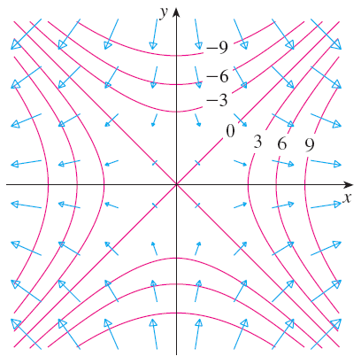
GRADIENT VECTOR FIELD
The figure shows such a plot—called a gradient vector field—for the function f(x, y) = x² – y² superimposed on a contour map of f.

Slide 249
SIGNIFICANCE OF GRADIENT VECTOR
As expected, the gradient vectors:
Point “uphill”
Are perpendicular to the level curves

